Slide 1
Supplemental document S1. Curation of cp32-related P-Ps into well defined groups and testing parameters for MinProteins, Composition and confidence levels
Slide S2. Curation of cp32-related P-Ps into a well-defined groups.
Slide S3. Cutoffs for MinProteins AB_1, P1_1, P1_2, N15, cp32
Slide S4. Cutoffs for MinProteins for SSU5-like P-P types
Slide S5. Search for cutoffs for profile-to-protein hits (example P1-like sequences) for Composition
Slide S6. Search for sizes of the P-P type specific composition including tolerances for miss-matches (example P1-like sequences)
Slide S7. Chosen parameters for Composition
Slide S8. P-P type specific size distribution and ranges

Slide 2
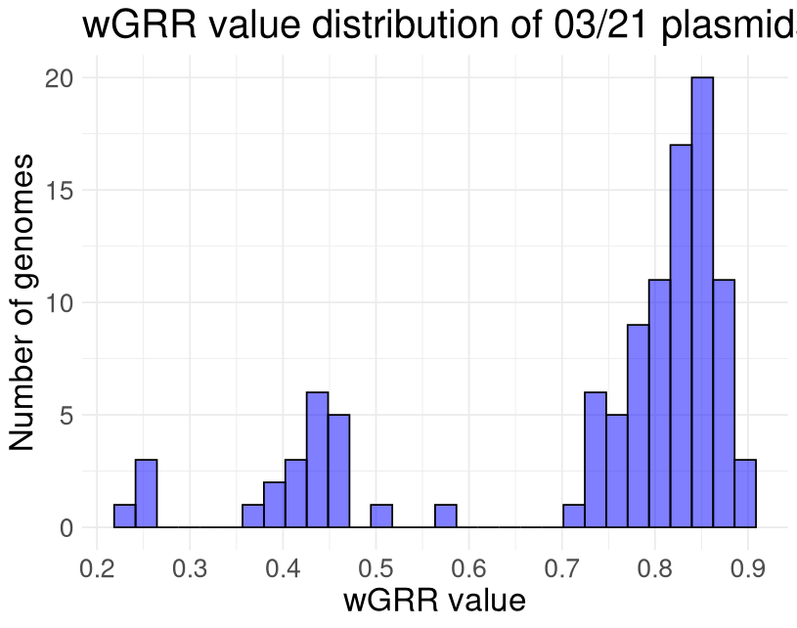
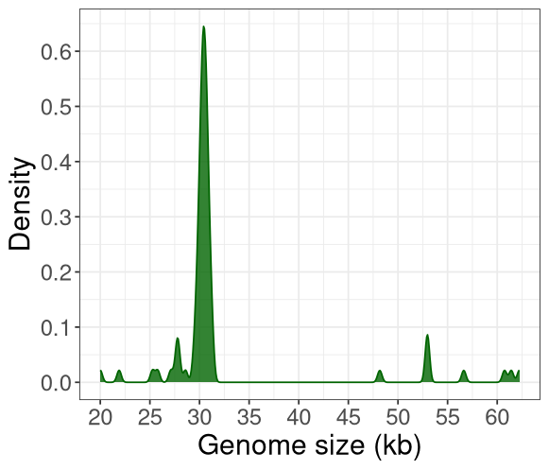
Curation of cp32 sequences into a well-defined group.
A
B
(A) wGRR values distribution for all non-chromosomal Borrelia and Borreliella sequences (of 03/21), that are homologous to cp32 P-Ps (at least 50% of homologous genes to sequences of (Faith et al., 2024)). Elements with wGRR >= 0.6 were added into a diverse cluster of cp32-like elements.
(B) All elements with sizes ranging from 27kb to 37kb (red dashed lines) were added into a well-related cp32 group.

Slide 3
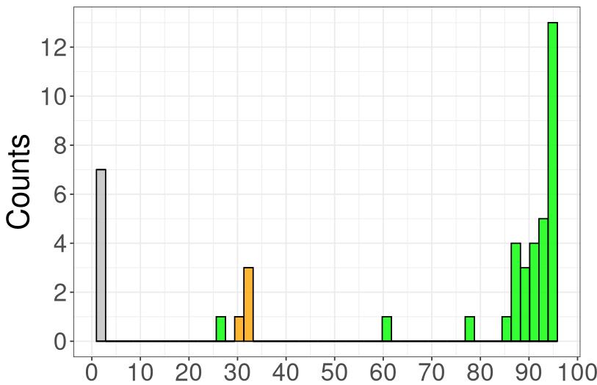
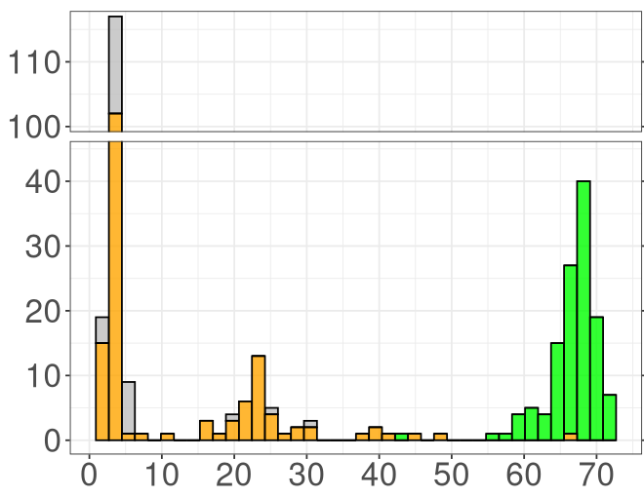
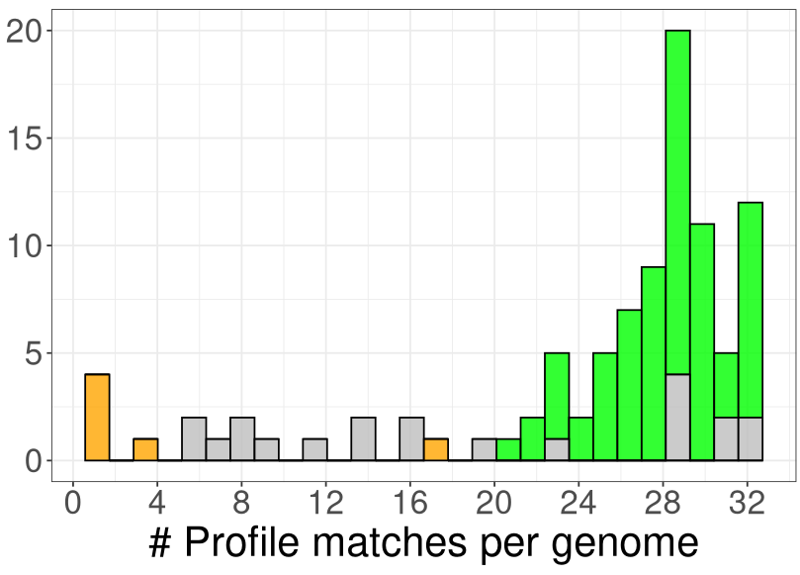
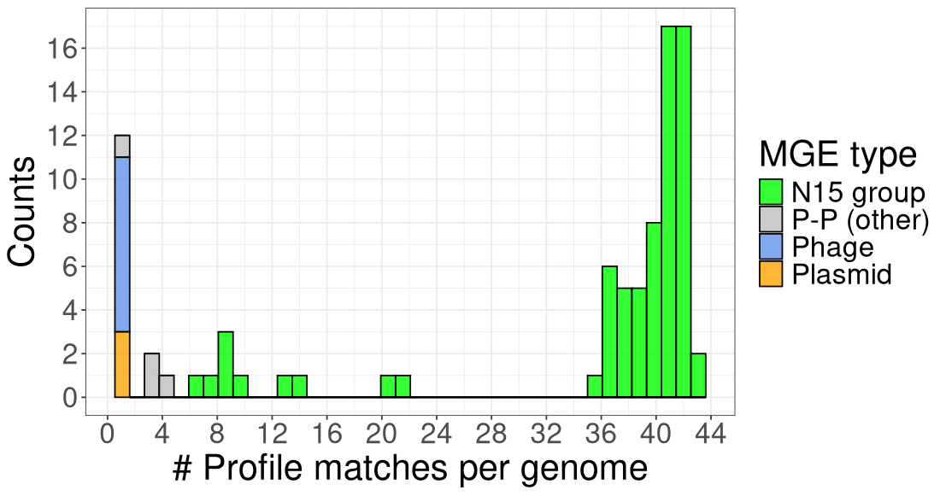
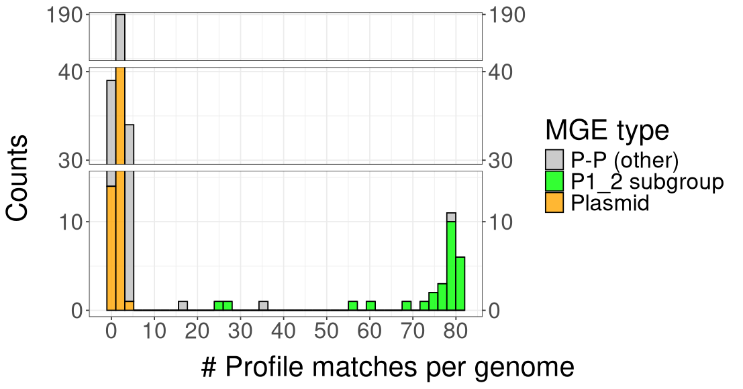
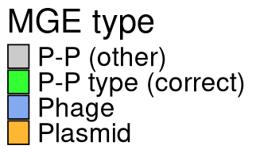
Cutoffs for MinProteins for AB_1, P1_1, cp32, N15 and P1_2 that facilitate differentiation between plasmid, phage and P-P (type) sequences.
AB_1
P1_1
cp32
55
49
18
N15
P1_2
7
46
* Arrows indicate short (incomplete) genomes.

Slide 4
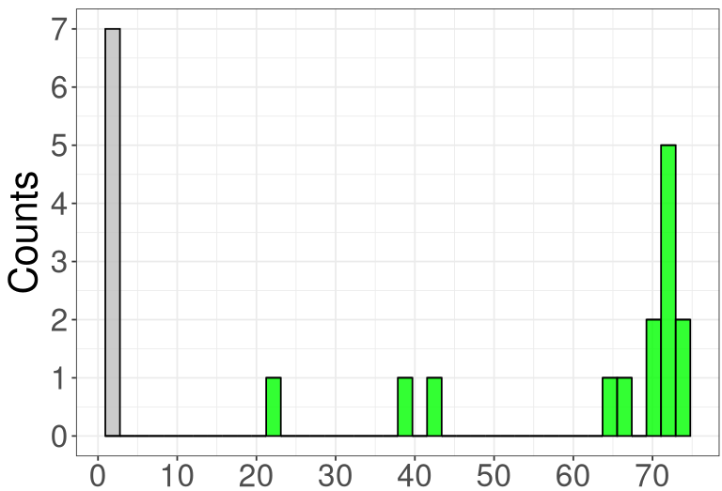
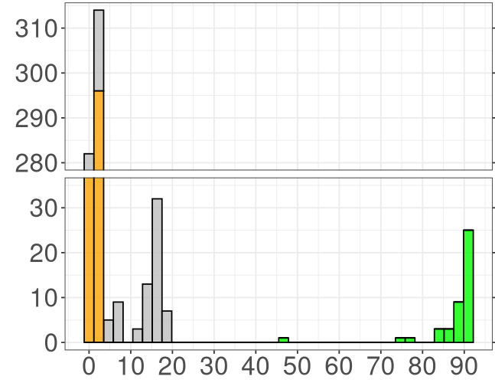
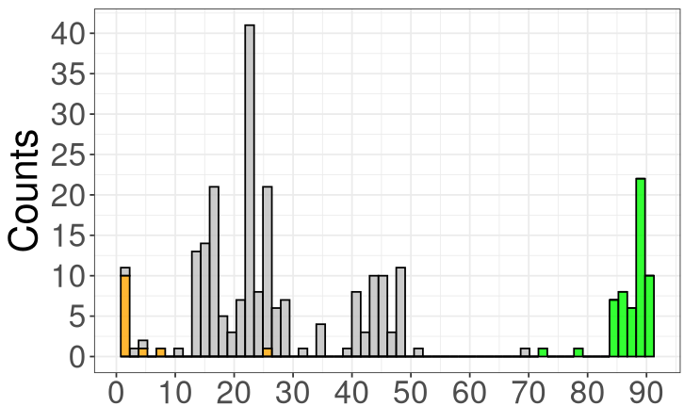
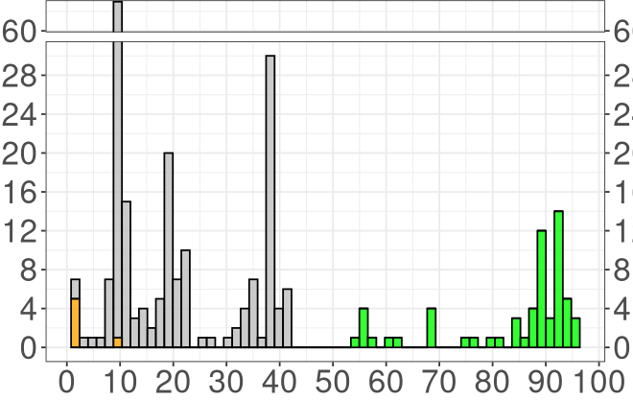
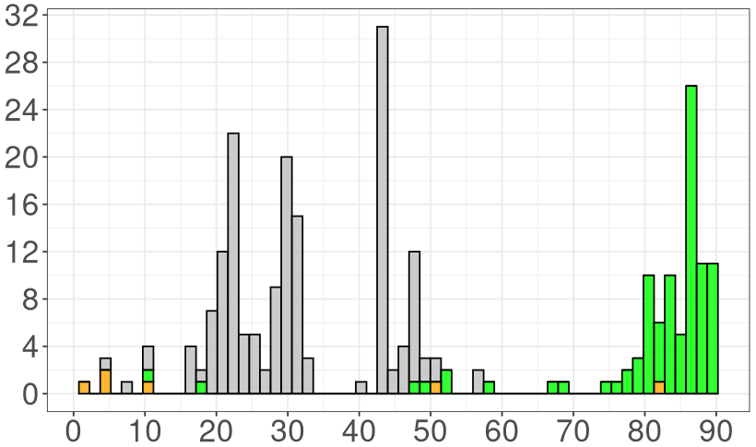
MinProteins cut offs for SSU5-related types.
pCAV
pMT1
30
50
* Arrows indicate short (incomplete) genomes.
** Hierarchical type assignment allows the exclusion of P-Ps from other types if they have more than 38 hits to pKpn.
SSU5_pHCM2
pSLy3
pKpn
71
38**
47

Slide 5
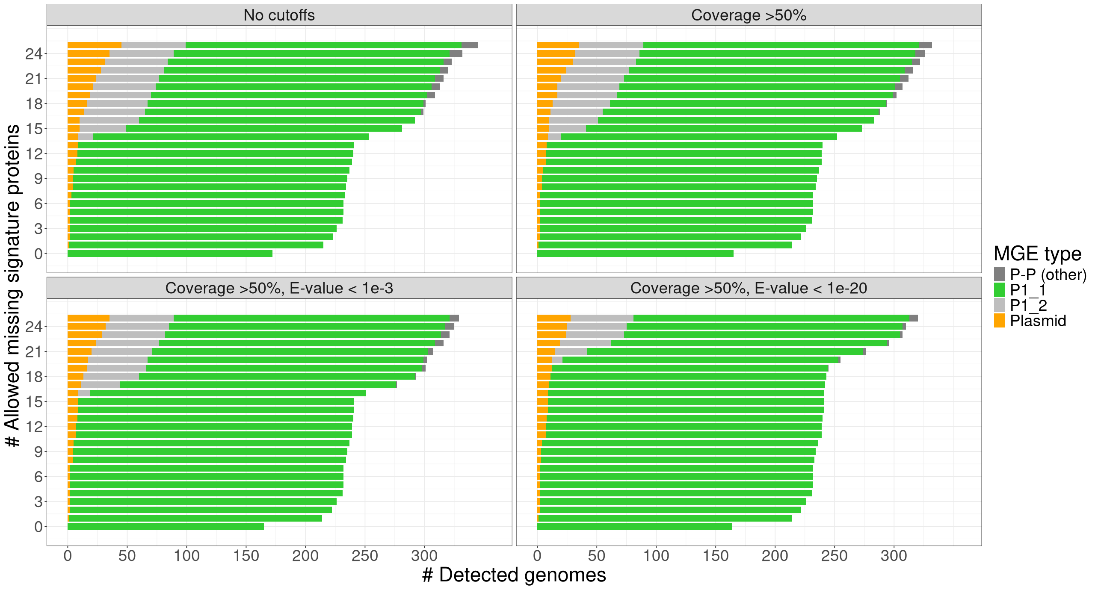
Tests of different parameters for protein to profile matches (for P1-like sequences) for Composition
A
B
C
D
Counts of sequences that match at least one of 79 unique P1_1 compositions (combination of conserved proteins in a confident P1-like element). By allowing miss-matches (number of missing conserved proteins, shown on Y-axis), we evaluated the completness of recovered genomes for: (A) all matches, (B) minimum profile coverage of 50%, (C) domain E-value ≤ 10⁻3 and a minimum coverage of 50%, and (D) a domain E-value ≤ 10⁻20 and a minimum coverage of 50%. We selected (B) 50% coverage to allow fewest miss-matches, but with good separation between P1_1, P1_2 and plasmid sequences.

Slide 6
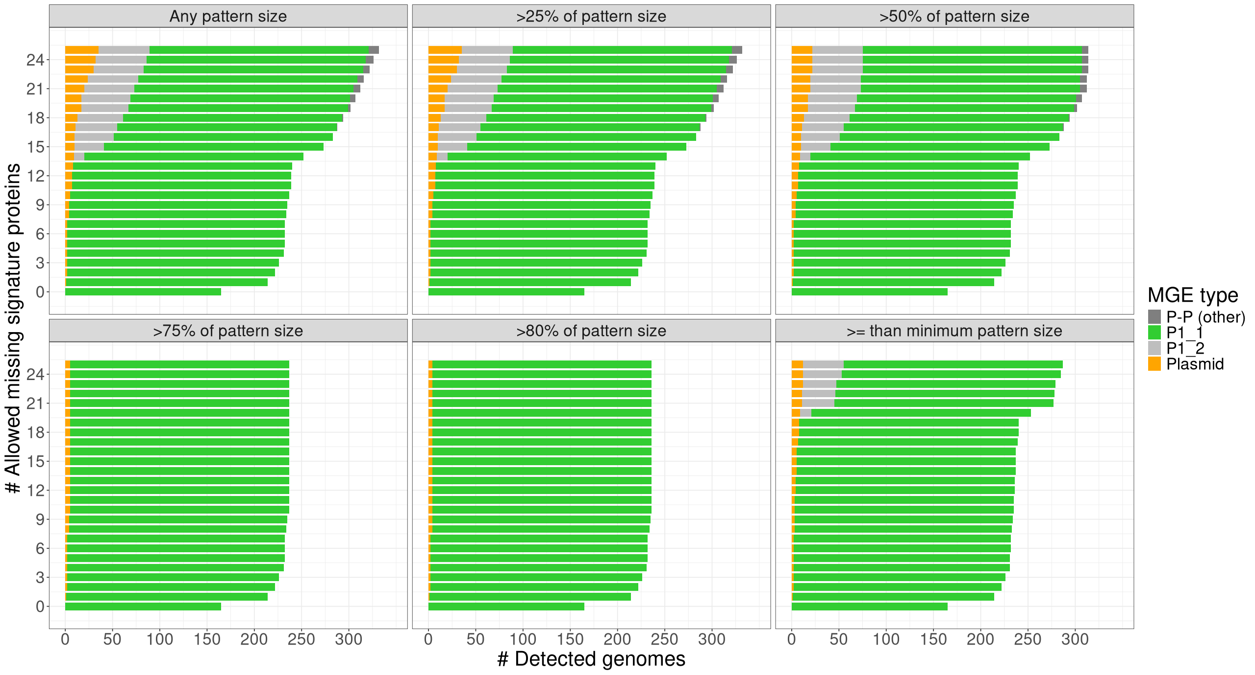
Search for number of miss-matches (tolerance) for accurate Composition prediction on P1-like sequences.
We allowed miss-matches (as fraction of the unique compositions of conserved proteins) for each of the 79 P1_1 compositions. We tested values starting from the size of the smallest combination, over 50% to >80%. The fraction (>75%) was chosen as it allowed clear separation between P1_1, P1_2 and plasmid sequences.

Slide 7
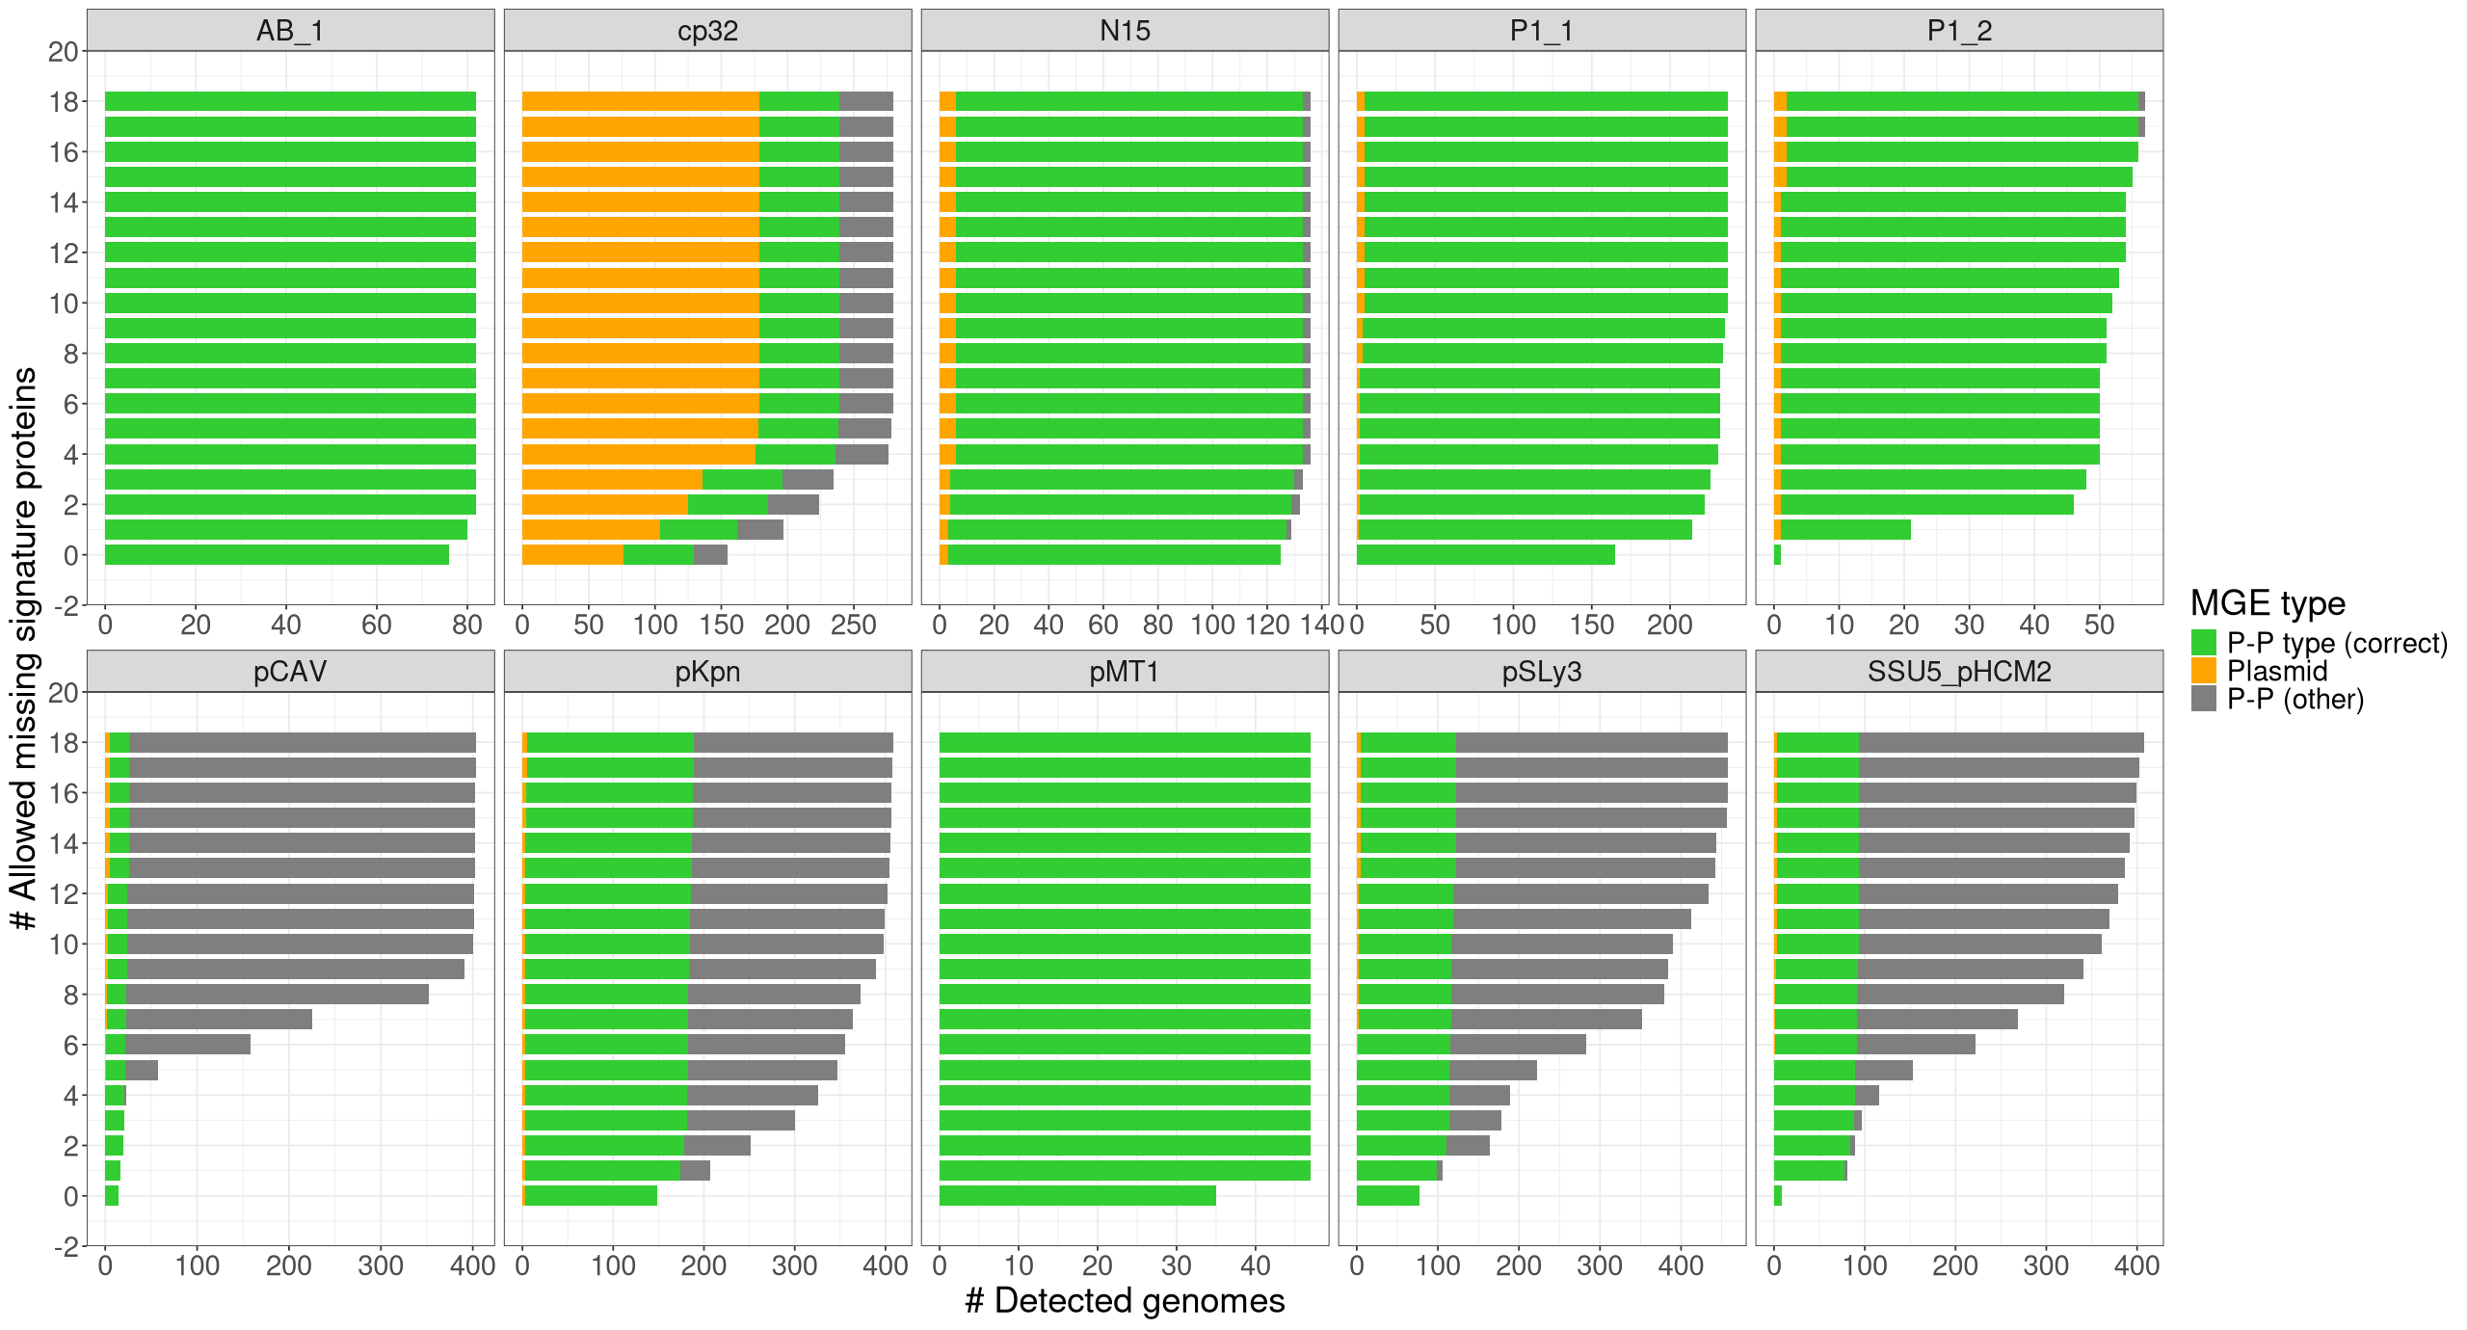
Search for Composition parameters (tolerance for miss-matches) for all P-P types
Profile-to-protein: ≥ 50% coverage, Composition match: ≥ 75% matching proteins + tolerance to gaps (indicated by arrows and listed in Table XXX).

Slide 8
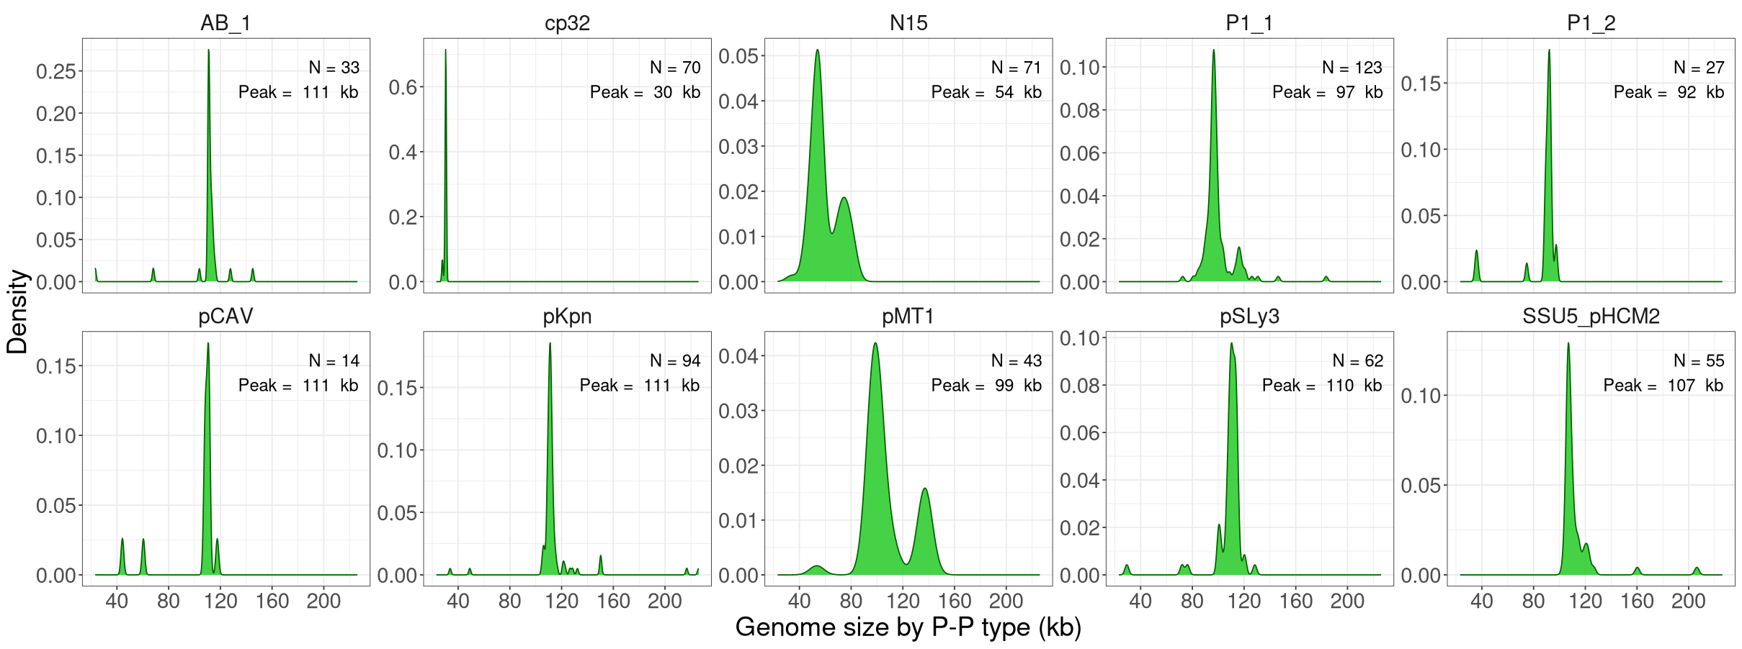
Genome size distributions per P-P type
Size distribution for each P-P type. Size ranges are set as mean size ± 3xSD (after excluding fragments and typical long elements, marked with arrows)

